Slide 1
BIOCHEMISTRY
DNA and Replication
ا . د . جمال احمد عبد الباري

Slide 2
Chromosomes :
Are DNA- protein complex or nucleoprotein the information transmitted by the genes from one cells to another is stored in the DNA, or in the specific base sequences of DNA macromolecules.
When new DNA is synthesized during cell division, the DNA molecules provided to the daughter cells are copies or duplicates of those of the parent cell.

Slide 3
Replication :
The process by which each DNA molecule directs the synthesis and specific the structure of newly formed DNA.
Mechanism of replication depend on
The structure of DNA.
Characteristics of the enzymes that catalyzed DNA synthesis.

Slide 4
Most of the original date of DNA replication were
obtained from studies of Escherichia Coli, this simple
cells contains neither a nucleus nor mitochondria. It is
only a membranous structure and has only one
chromosome, which composed of single molecule of
DNA.

Slide 5
General aspect of the replication
Both strands of the DNA are utilized as templates in the formation of new DNA.
RNA primer must be synthesized prior to the formation of new DNA.
Several types of DNA polymerases are involved in the replication.
Forming smaller fragments that are subsequently linked to each other.
Condensation of nucleotides always occurs from 3' → 5' terminus of the template DNA, while DNA that is being synthesized starts from 5'→3'.

Slide 6
In E. coil cells DNA replication starts at specific site called ori C.
The ori C locus contain only 245 base Paris. The ori C nucleotide sequence binds several unit of dnaA proteins to form a complex.
Then dna B and dna C proteins bind to this complex and as result of binding these proteins, the helical DNA is unwound.
At this site apart of DNA chain interacts with DNA- directed RNA polymerase also RNA- polymerase.

Slide 7
The substrates ATP, GTP, CTP and UTP are presents, RNA polymerase catalyses of RNA primer about 10-200 nucleotide in length.
The sequence of bases in RNA primer is directed by that of DNA and by base paring the RNA chain must grow in the direction a way from the initiation site.

Slide 8
In elongation stage, a DNA polymerase III*, requires ATP and coenzyme termed copolymerase III* responsible for arrange deoxyribonucleotides on the template DNA by forming complementary hydrogen-bond base pairs.
As a result of DNA III* action about 500-1000 deoxynucleotides are condensed and linked to RNA primer.
Then copolymerase III* is not required and., dissociated from the enzyme substrate system.

Slide 9
A number of RNA - DNA pieces along the DNA template called Okazaki fragments.
In mammals after many Okazaki pieces are generated the replication process begins to remover the RNA primer.
The removal of RNA primer involved DNA polymerase I.
This enzyme has 5'→3' exonuclease activity (an endonuclease activity can act at any where in the chain, not only at terminus).
Also the enzyme directing the synthesis from 3'→5' polymerization of deoxynucleotides triphosphate.

Slide 10
The final stage:
Is the closing the gaps between the fragment of DNA. This reaction is catalyzed by DNA ligase needed in E. coli NAD⁺ and in higher organism needed ATP.

Slide 11
Enzymes involved in DNA Replication
DNA- directed RNA polymerase:
Catalyzes the formation of the RNA primer.
DNA polymerase I:
Has both synthetic activity and 5'→3' exonuclease activity.
1. It catalyzes hydrolysis the RNA section.
2- Effects the elongation of new DNA from 3' terminus
of Okazaki fragments.
3- Has activity to hydrolysis deoxynucleotides phosphate in opposite direction to that of replication this used to remove the error base
4- This enzyme can remove defective bases and
clear the way for repair of damage DNA.

Slide 12
DNA-polymerase II:
Has 3'-5' exonuclease activity but not 5'-3' activity and acts with polymerase I.
DNA-polymerase III*:
Enzyme involved in the synthesis of new DNA on the RNA primer, and formation Okazaki fragments.
Copolymerase III*:
Required only for the initial linkage of the first deoxnucleotide to the 3' terminus of RNA primer.

Slide 13
In eukaryotic cells, there are three DNA polymerase called α, β, γ there differs in their substrate and function.
In mammalian cell there is polymerase α,β,γ
Polymerase α:
Present in nucleus and responsible for chromosome replication.
Polymerase β:
Low m.wt, present in nuclei and used for DNA repairs.
Polymerase γ:
A mitochondrial DNA polymerase is responsible for replication of mitochondria genome.

Slide 14
DNA ligase:
Is required to joint these short pieces into phosphodiester
linkage .
Used to seal deoxyribonucleotide segments during gene recombination.
To close segments of DNA undergoing repair.
To joint the mitochondrial DNA.

Slide 15
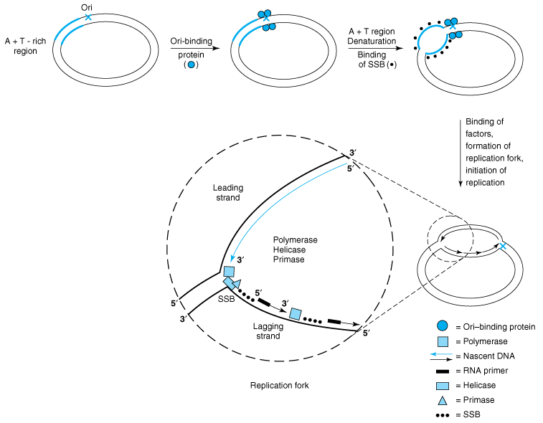

Slide 16
Thank You

